Slide 1


PowerShell Workshop
Getting started
Jeffrey Snover
Jason Helmick
Technical Fellow/Microsoft
Author/Pluralsight
@JSnover
@theJasonHelmick

Slide 2
Where can I get the slides and labs?
http://Github/theJasonHelmick/SpiceWorld

Slide 3
Course Topics
Getting Started with PowerShell
01 | Introduction | 06 | The pipeline : Deeper
02 | The Help system | 07 | The Power in the Shell - Remoting
03 | The pipeline : Getting connected | 08 | Getting prepared for automation
04 | Extending the shell | 09 | Automation in scale - Remoting
05 | Objects for the Admin | 10 | Introducing scripting and toolmaking

Slide 4
Why PowerShell Matters
Automation has a major impact to your business and its agility
Automate repetitive tasks
Deliver reusable solutions
Reduce failure due to human mistakes
PowerShell is your gateway to configuration management and DevOps

Slide 5
Why DevOps Matters
Reduced outages
Rapid deployment
Run towards change, not away
Fail often, recover fast

Slide 6
Why DevOps Matters
High performers decisively outperform lower preforming competition
Deploy 200 times for frequently
Recover 24 times faster
3 times lower change failure rate
https://puppet.com/resources/white-paper/2016-state-of-devops-report

Slide 7
Getting Started

Slide 8
Module Overview
The purpose for PowerShell
Installing PowerShell – Windows Management Framework
Launching PowerShell for the administrator
Customize the shell for comfort
Getting familiar with the shell

Slide 9
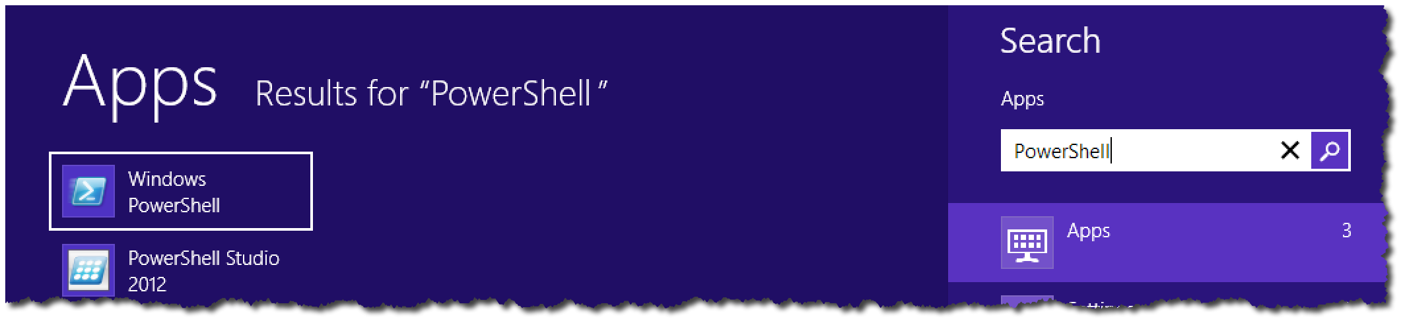

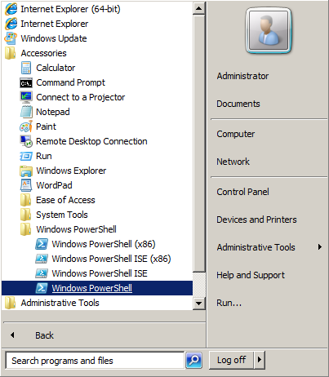
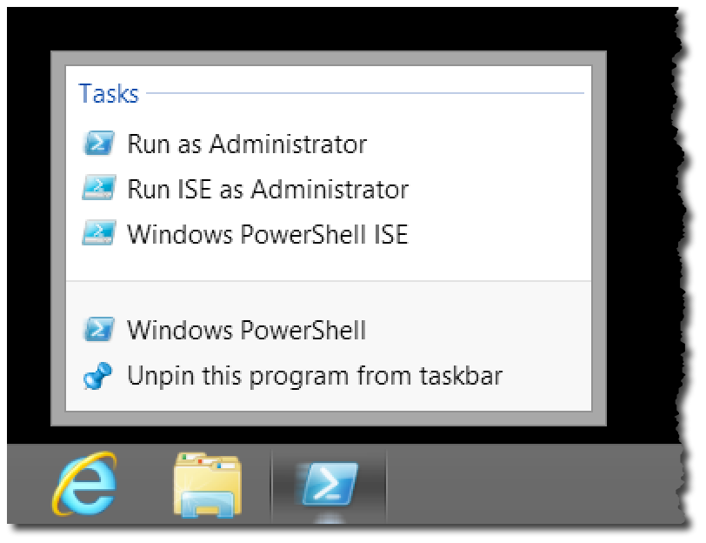
Launching PowerShell for the Administrator

Slide 10
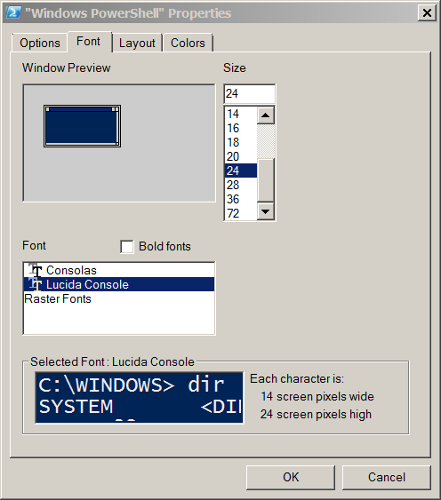
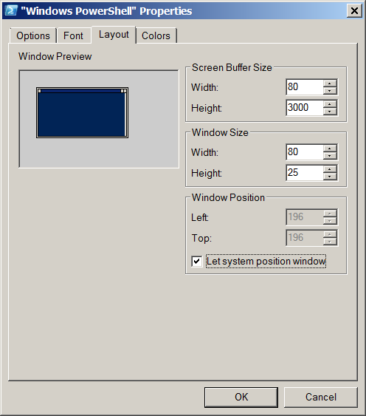
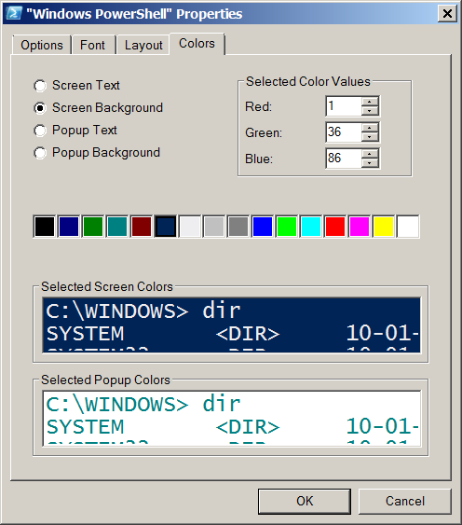
Customize the shell for comfort

Slide 11
Getting familiar with the shell
Cmdlets : Verb – Noun
Native commands work!
Examples – Ping, IPConfig, calc, notepad, mspaint
cls - Clear-Host
cd - Set-Location
dir, ls - Get-Childitem
type, cat - Get-Content
Copy, cp - Copy-item

Slide 12
The Help System

Slide 13
Module Overview
Why you need help
Updatable Help
Discoverability with the Help system
Understanding Syntax
Real-World using Help

Slide 14
Why you need help
Vast resource at your finger tips to help make you successful
Don’t memorize – Discover!
Thousands of cmdlets – all have help!
Scripting resources and information
Advanced PowerShell configuration information

Slide 15
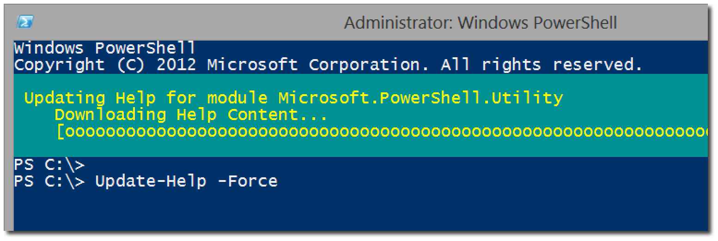
Updatable Help
Update to the latest version of Help
Save-Help to save to a local location

Slide 16
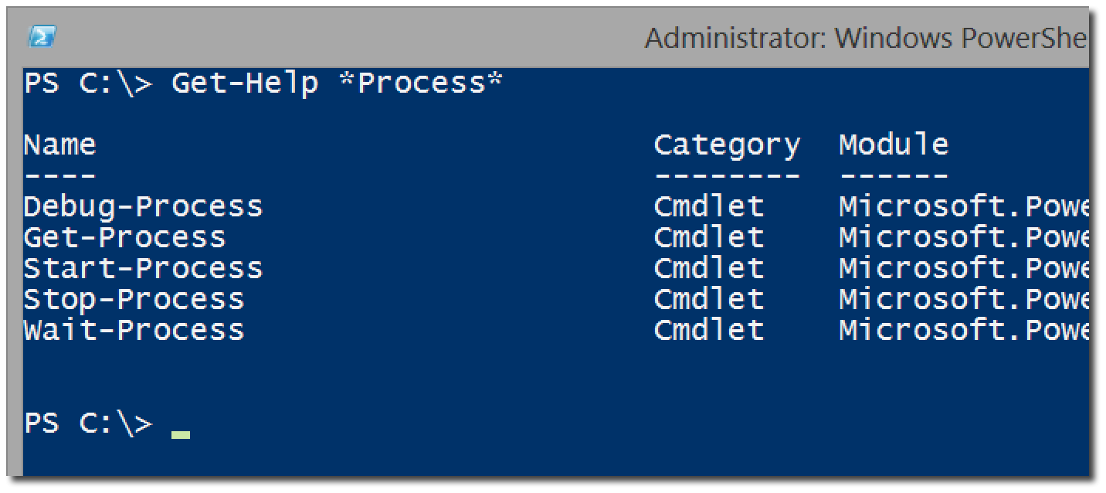
Discoverability with the Help system
Get-Help versus Help and Man
Help <cmdlet>
Help *partial*
Help <verb/noun>
Help <cmdlet> -Full
Help <cmdlet> -Online
Help <cmdlet> -ShowCommand
Get-Help About_*

Slide 17
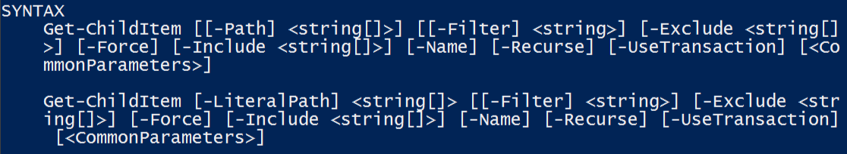
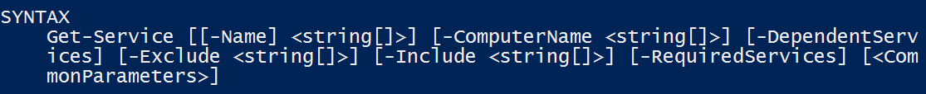
Understanding Syntax
Parameter sets
The meaning of Syntax
- Indicates A Parameter
[] Argument Accepts Multiple Values
[Param] is Positional
<> Indicates Arguments
[Param Arg] is Optional

Slide 18
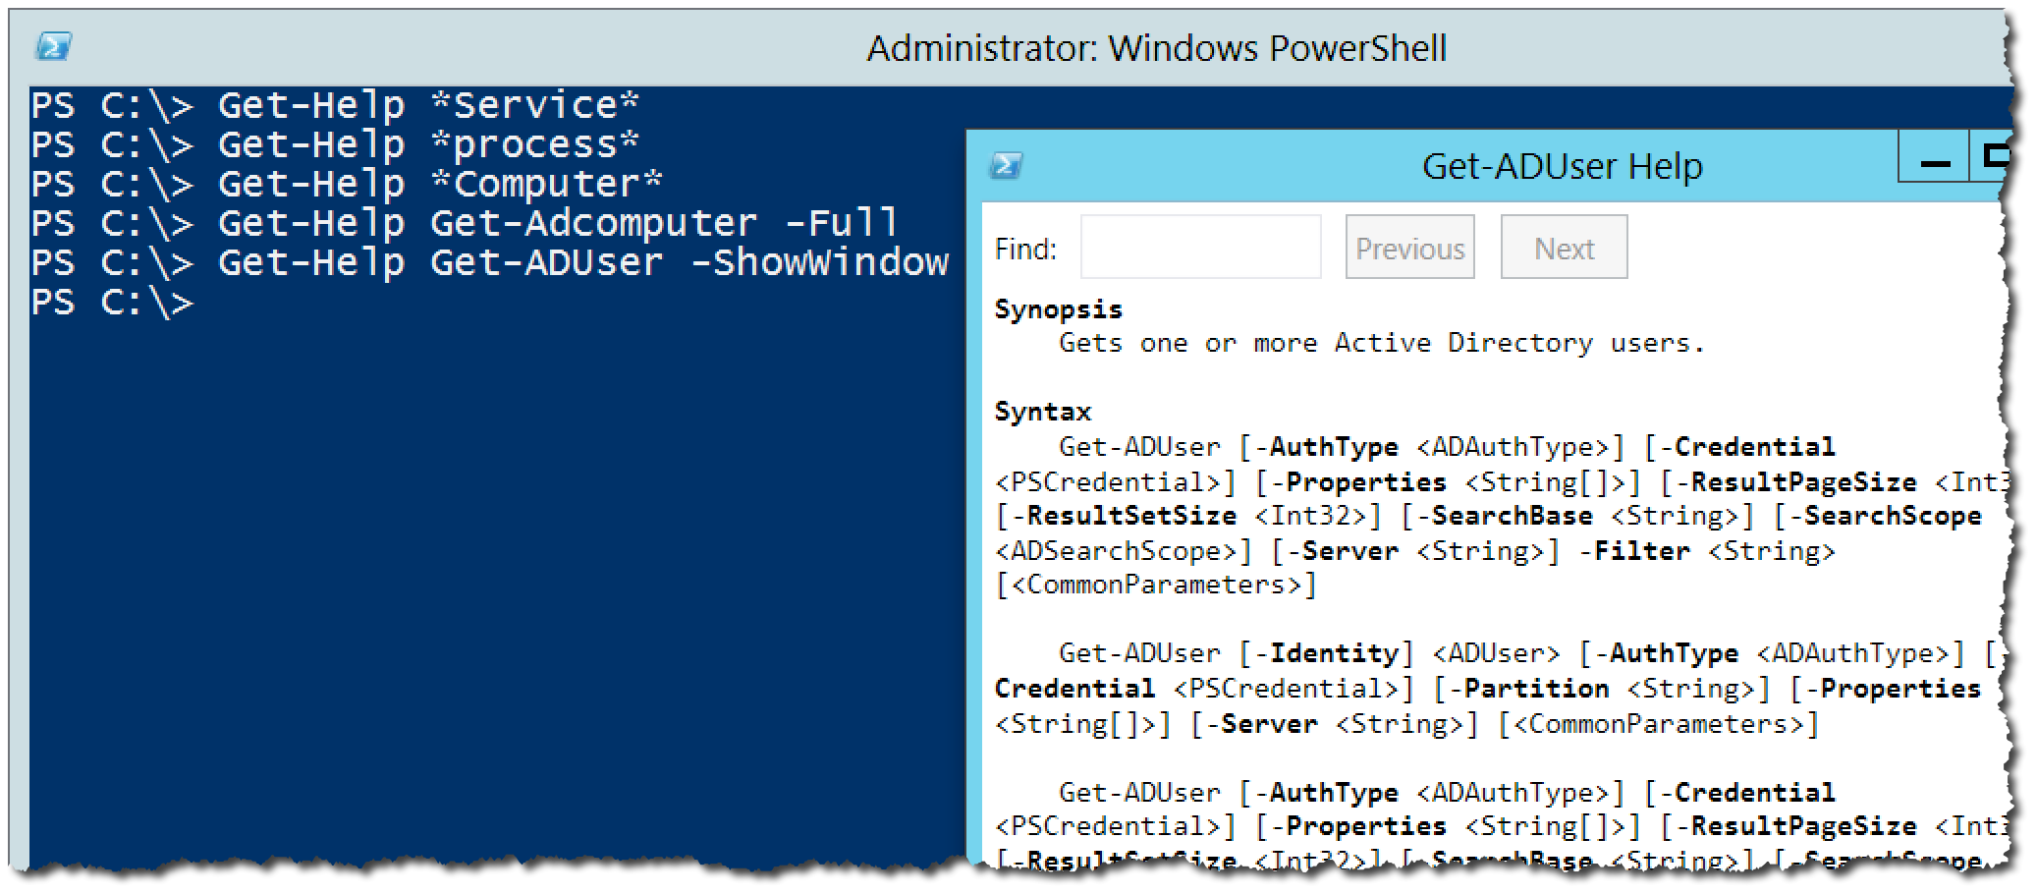
Real-World using Help

Slide 19
The Pipeline: Getting Connected

Slide 20
Module Overview
What’s the pipeline and what does it do?
Exporting/Importing CSV
Exporting/Importing XML
Other files and printers
Displaying information in a GUI
Making a webpage of information
Cmdlets that kill

Slide 21


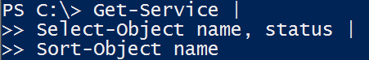
What’s the pipeline and what does it do?
Pipe character located above the Enter key
Connects cmdlets to produce better results
Can be broken into several lines to increase readability

Slide 22
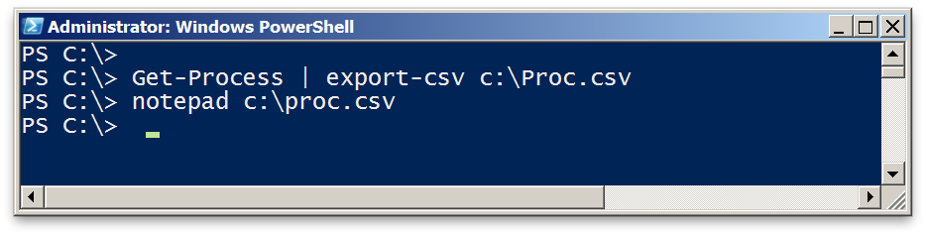
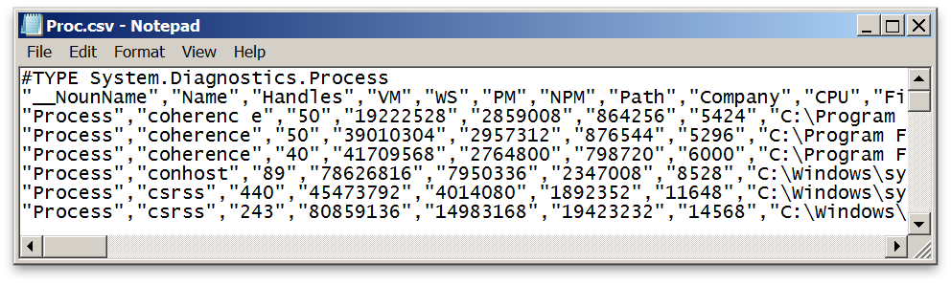
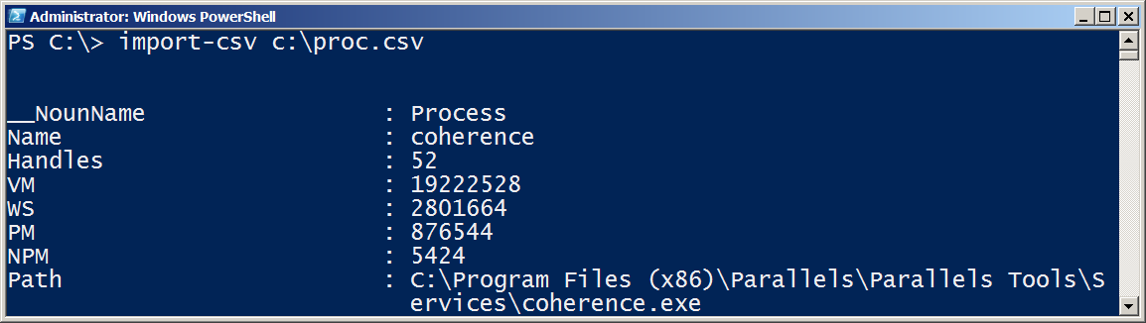
Exporting/Importing CSV

Slide 23
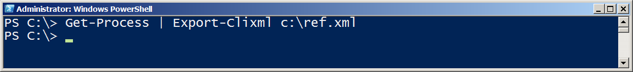
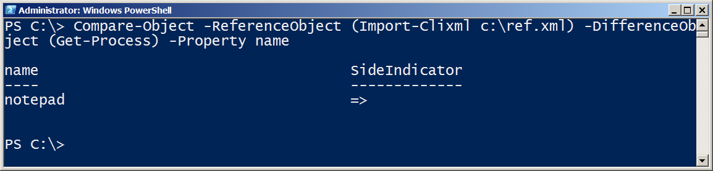
Exporting/Importing XML

Slide 24
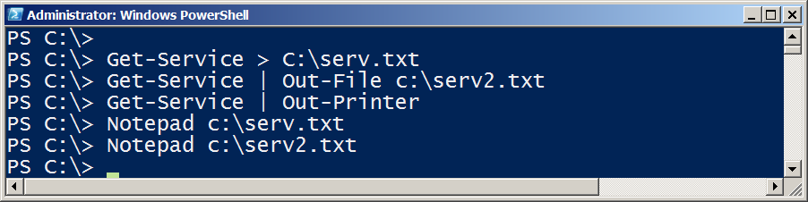
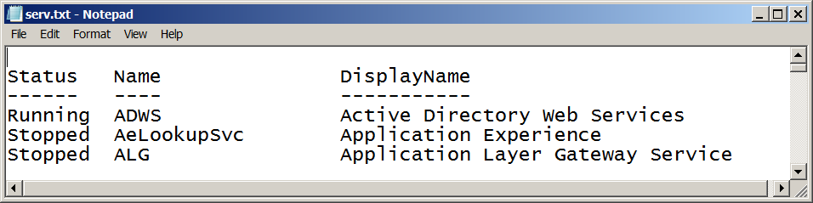

Other files and printers

Slide 25
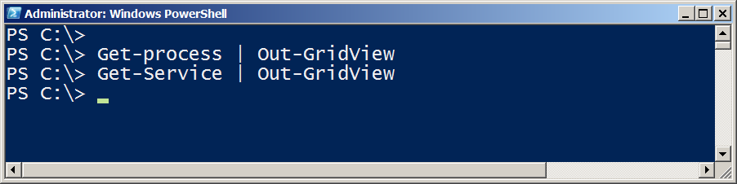
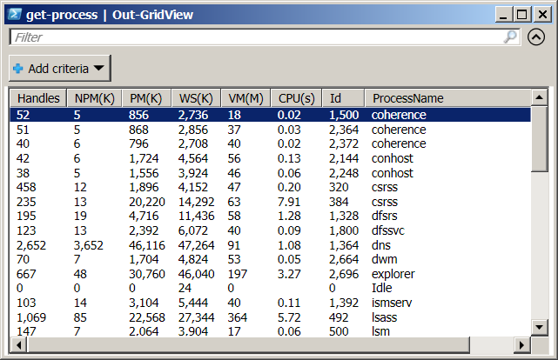
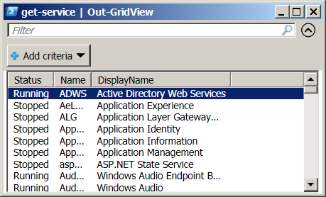
Displaying information in a GUI

Slide 26
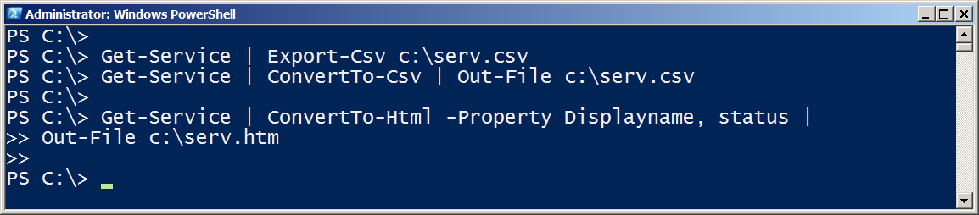
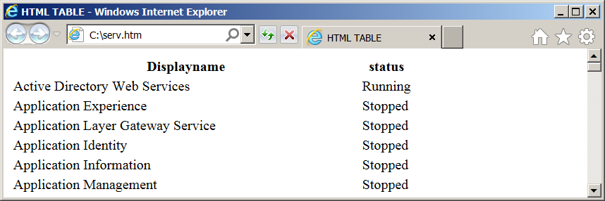
Making a webpage of information

Slide 27

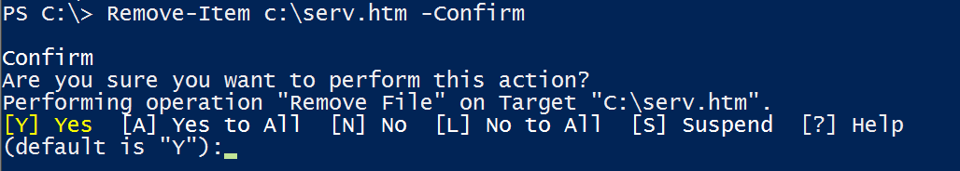
Cmdlets that kill
Stop-Process / kill
Stop-service
$ConfirmPreference
$WhatIfPreference
-Confirm
-Whatif

Slide 28
Extending the Shell

Slide 29
Module Overview
Finding and adding Modules
Discovering new commands
The real world of cmdlets

Slide 30
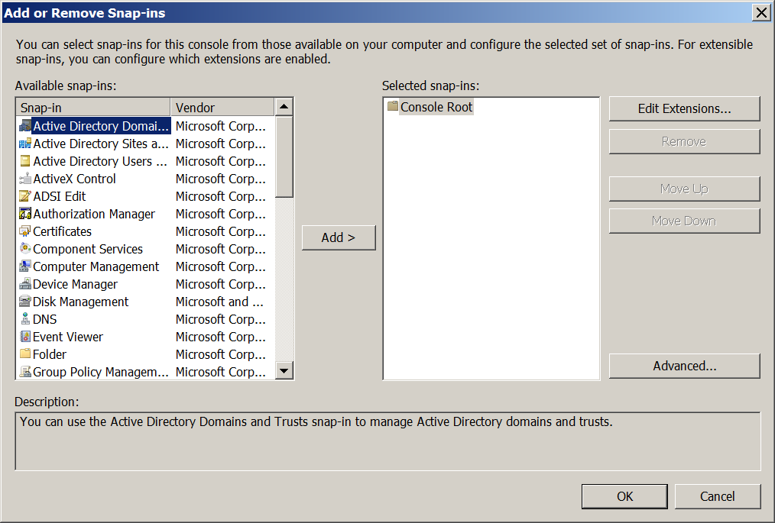
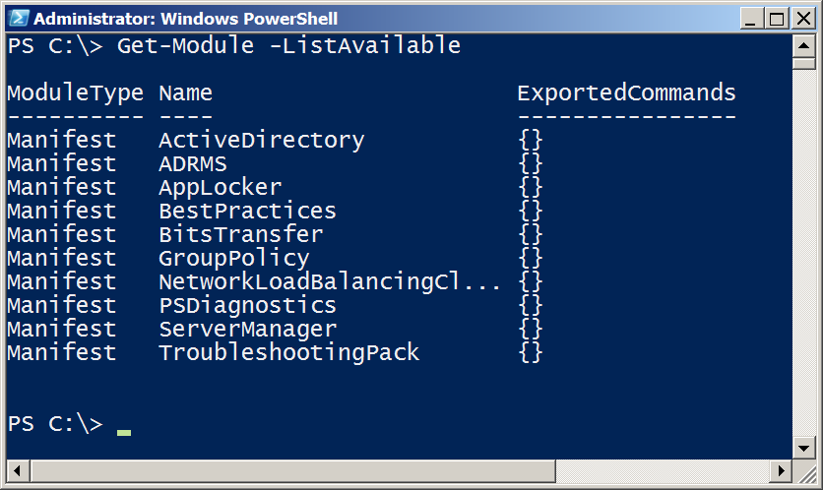
Like the MMC - One Shell does it all

Slide 31
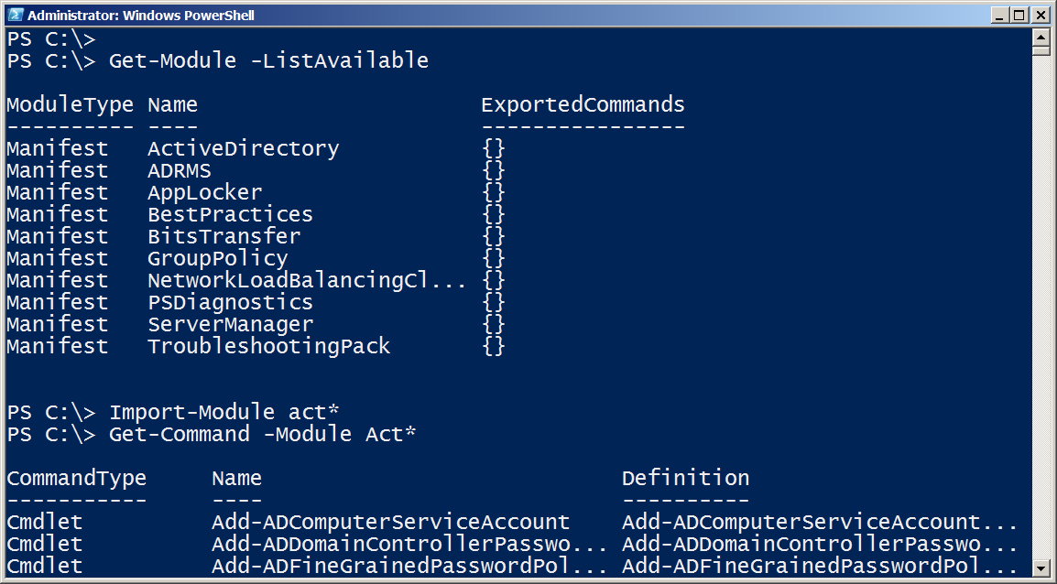

Finding & Adding Modules

Slide 32
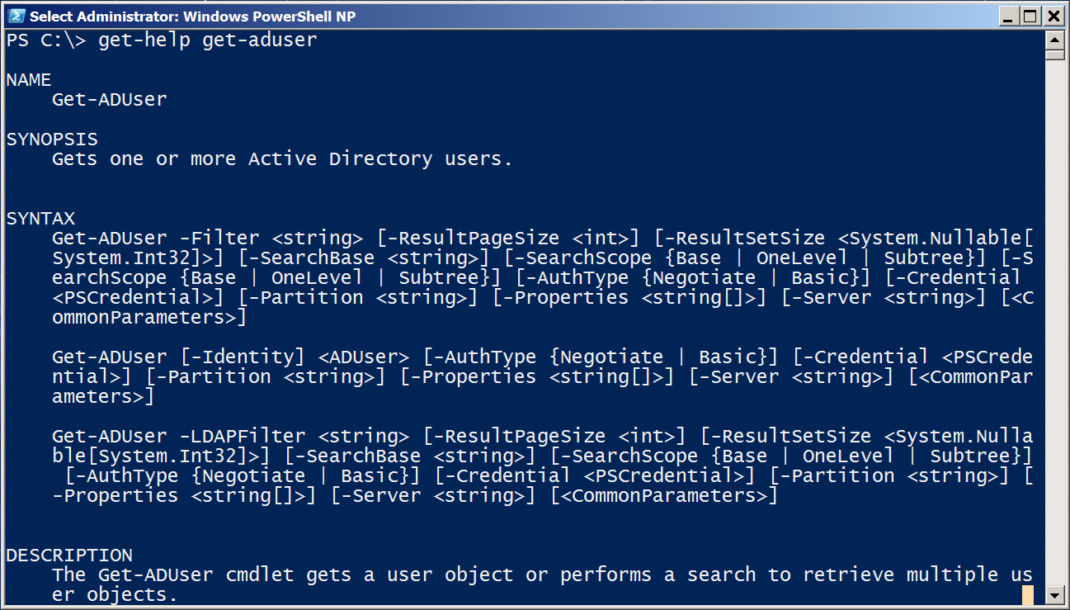
Discovering new commands

Slide 33
Objects for the Admin

Slide 34
Module Overview
Object across the pipeline
Getting the information you need
Sorting Objects
Selecting Objects
Custom Properties
Filtering data
Methods – When no cmdlet exists

Slide 35
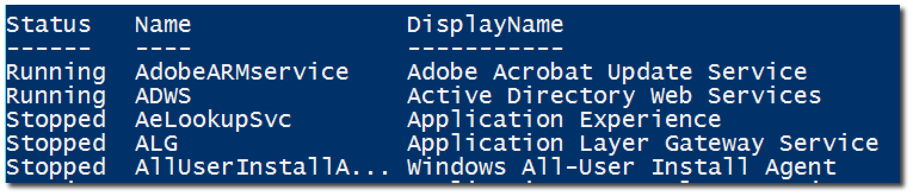
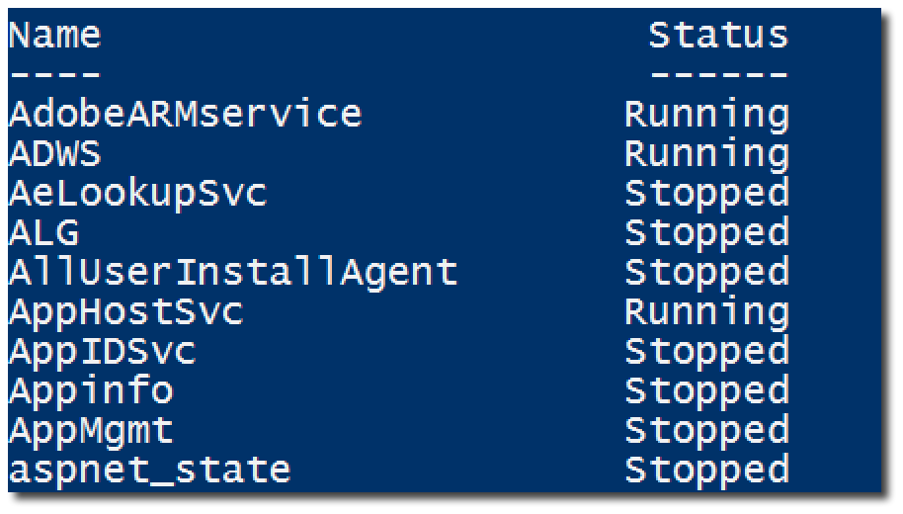
Object across the pipeline

Slide 36
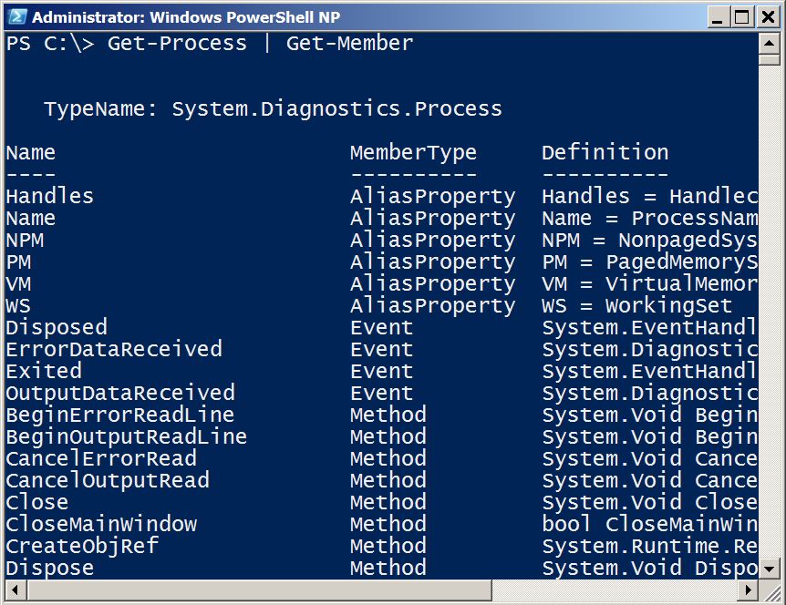
Getting the information you need
Get-Member (gm)
TypeName is a unique Windows assigned name
Displays the properties and methods of an object
Properties are potential columns of information
Methods are the potential actions that can be taken

Slide 37
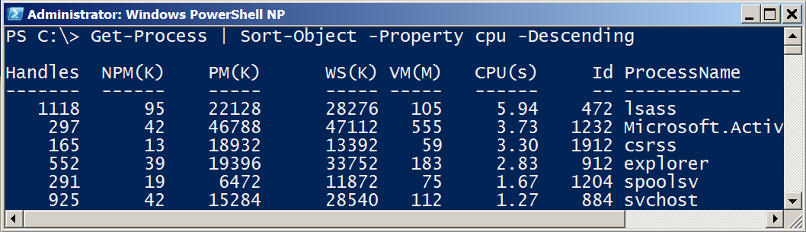
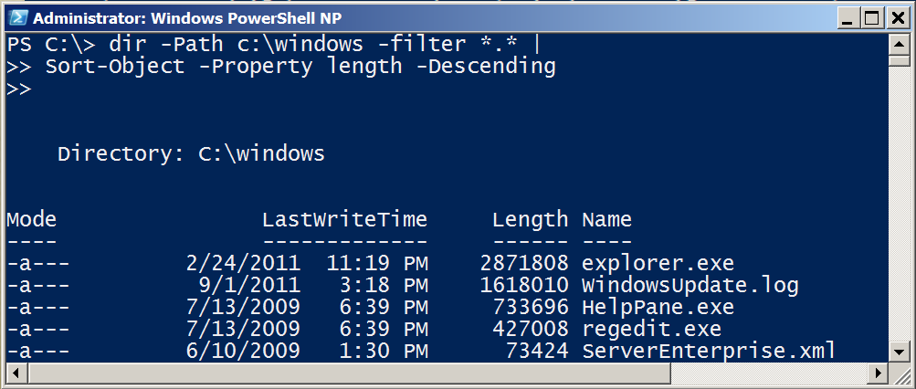
Sorting Objects
Sort-Object sorts properties.
Use Get-Member to see a list of properties

Slide 38
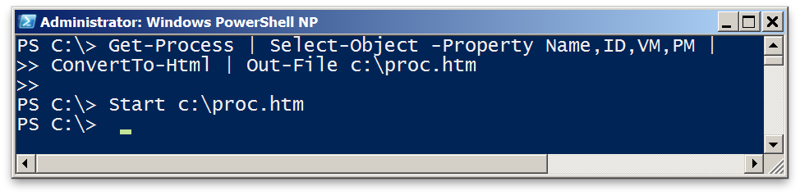
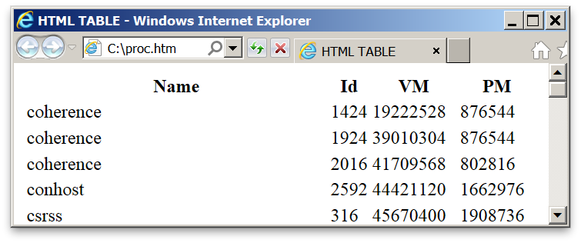
Selecting Objects
Select-Object selects properties.
Use Get-Member to list properties to select from.
-first and -last restrict list of rows displayed.

Slide 39
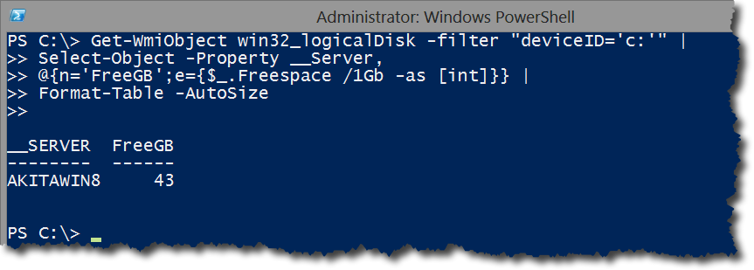
Custom Properties

Slide 40
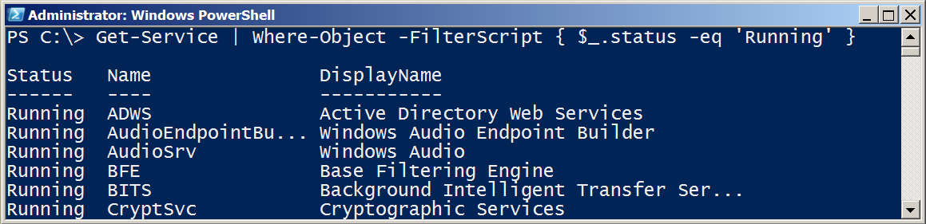
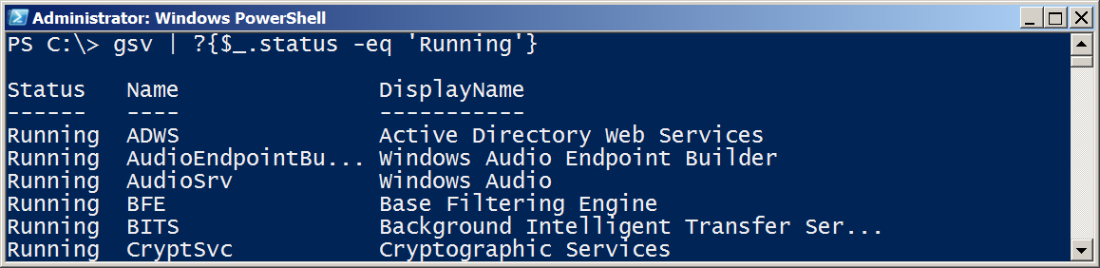
Filter Object Out of the Pipeline

Slide 41
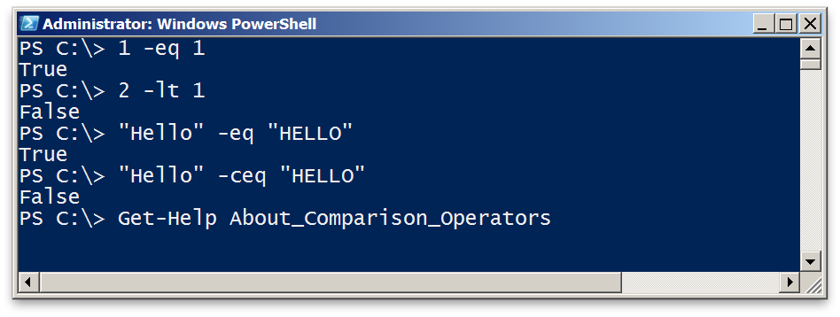
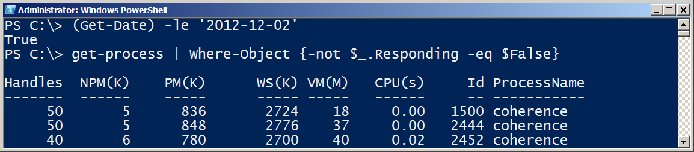
Comparison Operators
Comparison returns boolean True or False
Comparison can be case-sensitive using ‘c’ prefix
For complete description, see About_Comparison

Slide 42
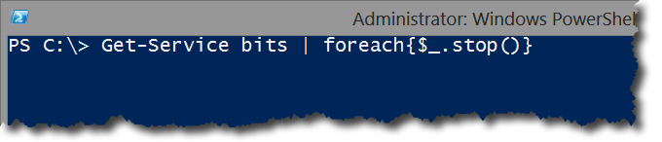
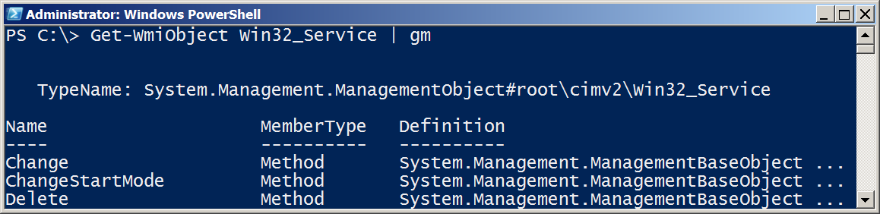
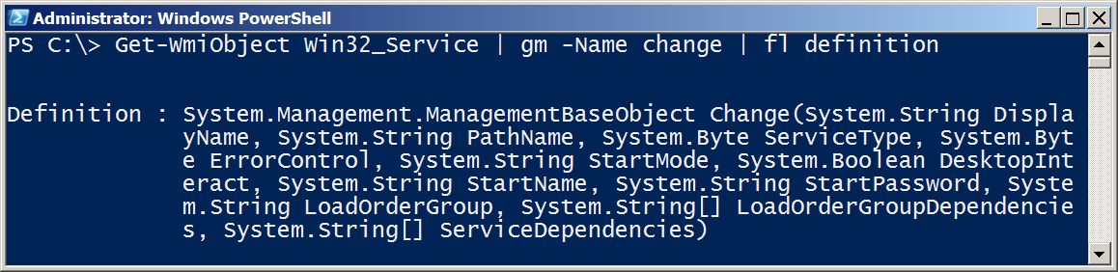
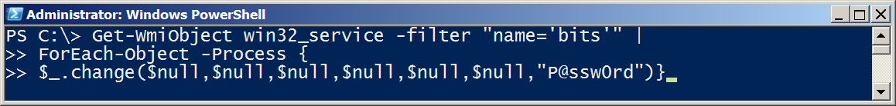
Methods – When no cmdlet exists

Slide 43
06 | The Pipeline : Deeper
Jeffrey Snover | Distinguished Engineer & Lead Architect
Jason Helmick | Senior Technologist, Concentrated Technology

Slide 44
The Pipeline: Deeper

Slide 45
Module Overview
How the pipeline really works - The 4 step solution
ByValue
ByPropertyName
What if my property doesn’t match – Customize it!
The Parenthetical – when all else fails

Slide 46
How the pipeline really works - The 4 step solution

Slide 47
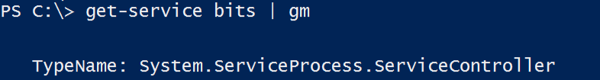


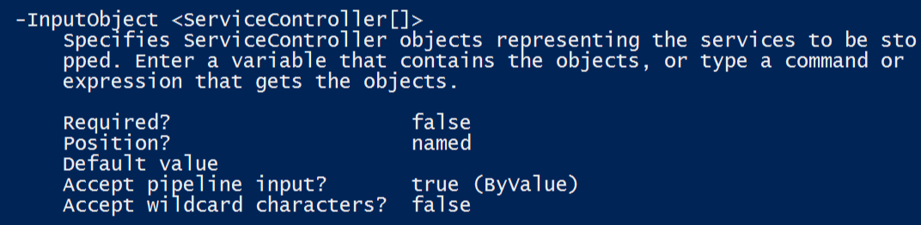
ByValue
1. Get-Service passes ServiceController objects to the pipeline
2. Does Stop-Service accept ServiceController Objects?
3. Help Stop-Service -Full
displays a parameter that accepts ServiceController ByValue

Slide 48
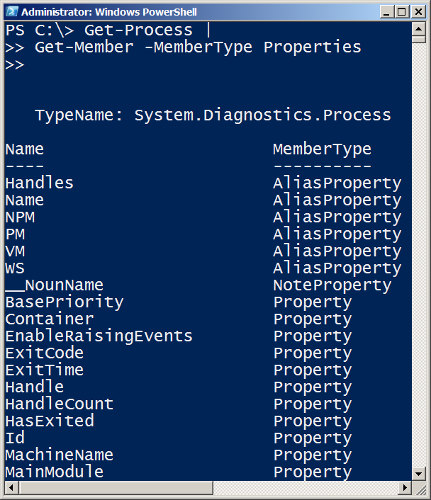
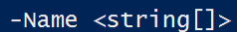

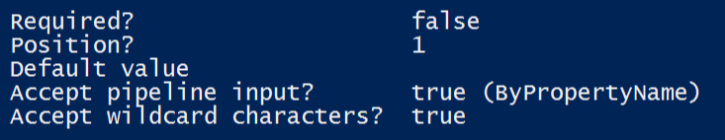






ByPropertyName

Slide 49




ByPropertyName
1. Get-Process is passing a “Process” Object
2. Stop-Service does not support accepting “Process” objects ByValue, so PowerShell checks what can be accepted ByPropertyName.
3. -Name does accept strings ByPropertyName, and the objects in the pipeline are labeled as a Name property
4. Stop-Service attempts to use the objects for its -Name, in this example, fails

Slide 50


What if my property doesn’t match – Customize it!

Slide 51



The Parenthetical – when all else fails
1. I want to pass a list of computer names to Get-Service. Why does this fail?
2. -Name and -InputObject accept pipeline input ByValue, not -Computername. -Name accepts text, and then causes the failure.
Parenthesis don’t rely on binding and attach information directly to the desired parameter.

Slide 52






The Parenthetical – when all else fails
Returns a collection (table)
of objects.
Returns string contents

Slide 53
The Power in PowerShell - Remoting

Slide 54
Module Overview
Overview of Remoting
Enable Remoting
One-To-One
One-To-Many
Not the end yet!

Slide 55











Overview of Remoting

Slide 56




Enable Remoting
PowerShell Remoting is already enabled in Server 2012
Computer Configuration/Policies/Administrative Templates/Windows Components/Windows Remote Management

Slide 57

One to One - Interactive

Slide 58


One-To-Many

Slide 59

PowerShell Web Access
PowerShell – Anywhere, anytime, on any device!
Install-WindowsFeature –Name WindowsPowerShellWebAccess
Get-Help *Pswa*
Install-PswaWebApplication –UseTestCertificate
# Use the –useTestCertificate for testing (Expires in 90 days)
Add-PswaAuthorizationRule –userName <Domain\User | Computer\user> -ComputerName <Computer> -ConfigurationName AdminsOnly

Slide 60
Not the end yet!
More to come!
Managing in scale and in real time!
Automation and scripting!
Great resource: Free!
Secrets of PowerShell Remoting – Don Jones and Tobias Weltner
http://powershell.org/wp/powershell-books/

Slide 61
Automation in Scale - Remoting

Slide 62
Module Overview
Reusable Sessions
Sessions with Invoke-Command
Real-world deployment of a website
Getting commands from anywhere

Slide 63


Reusable Sessions

Slide 64


Sessions with Invoke-Command

Slide 65

Getting commands from anywhere - Implicit Remoting

Slide 66
Introduction to Toolmaking

Slide 67
Module Overview
The new ISE
Making commands repeatable
Adding parameters to your script
Documenting your script
Turning your script into a tool for others
Storing your tools in a module

Slide 68
Execution Policy
By default, PowerShell does not run scripts.
Get/Set-ExecutionPolicy
Restricted
Unrestricted
AllSigned
RemoteSigned
Bypass
Undefined
Can be set with Group Policy

Slide 69




Variables: A place to store stuff
Use $ to create and use variables
Can contain letters, numbers, spaces and underscores
Don’t persist after Shell exits
New-Variable
Set-Variable
Get-Variable
Clear-Variable
Remove-Variable
Note: The $ is not part of the variable name, it’s a cue to access the contents of the variable

Slide 70

Making commands repeatable

Slide 71

Adding parameters to your script

Slide 72

Documenting your script

Slide 73

Turning your script into a tool for others

Slide 74

Storing your tools in a module

Slide 75
Introduction to PowerShell Desired State Configuration

